Slide 1
Internship Presentation
Name: Arbaaz Khan
Roll No.: 17
Intern @ Elite Software

Slide 2
Domain and Sub Domain
Domain
Domain Name is basically the name which represents the website on web.
This is what users type in a browser's search bar to directly access your website. A domain name is unique and cannot be shared between different sites.
Example: www.google.com
Sub Domain
Subdomains are the part of a domain that comes before the main domain name and domain extension.
A subdomain is a prefix added to a domain name to separate a section of your website. They are used to manage extensive sections that require their own content. They act as separate website.
Example: For a domain www.example.com a subdomain can be www.blogs.example.com which can used to represent a separate section for blogs.
ICANN: (Internet Corporation for Assigned Names and Numbers) Maintains database of domains.
whois.com: website which shows the information of domain.
DNS: Stands for Domain Name System which translates domain Name into IP Address.

Slide 3
HTML and CSS
HTML
HTML stands for Hyper Text Mark-up Language. It is the standard mark-up language for creating Web pages.
HTML describes the structure of a Web page.
HTML consists of a series of elements which tell the browser how to display the content over the internet.
CSS
CSS stands for Cascading Style Sheets.
It describes how HTML elements are to be displayed on web browser.
CSS saves a lot of work as we can control the layout of multiple web pages all at once
External stylesheets are stored in CSS files.

Slide 4
Bootstrap
Bootstrap is a free front-end framework for faster and easier web development.
Bootstrap is the most popular CSS Framework for developing responsive and mobile-first websites.
Bootstrap also gives you the ability to easily create responsive designs
A website is responsive if it automatically adjust its content to look good on all devices, from small phones to large desktops.
Bootstrap using CDN:
CDN stands for Content Delivery Network
When you don’t want to install bootstrap and just want to include bootstrap in your Website, then Bootstrap via CDN comes into play.
To use Bootstrap via CDN all we need is to include its link and script in our header section of webpage.
The benefits of using a CDN are that it can improve the speed of delivery of content, it can improve the reliability of delivery of content, and it can reduce the cost of delivery of content.

Slide 5
Web Hosting and Server
Web Hosting
web hosting is the process of renting or buying space to house a website on the World Wide Web. Website content such as HTML, CSS, and images has to be housed on a server to be viewable online.
Web hosting is basically a process of using a server to host a website.
It enables website to be accessible to users via internet.
It allows individuals and organizations to make their website accessible through WWW.
Server
A server is a software or hardware device that accepts and responds to requests made over a network. The device that makes the request, and receives a response from the server, is called a client.
On the Internet, the term "server" commonly refers to the computer system that receives requests for a web files and sends those files to the client.

Slide 6
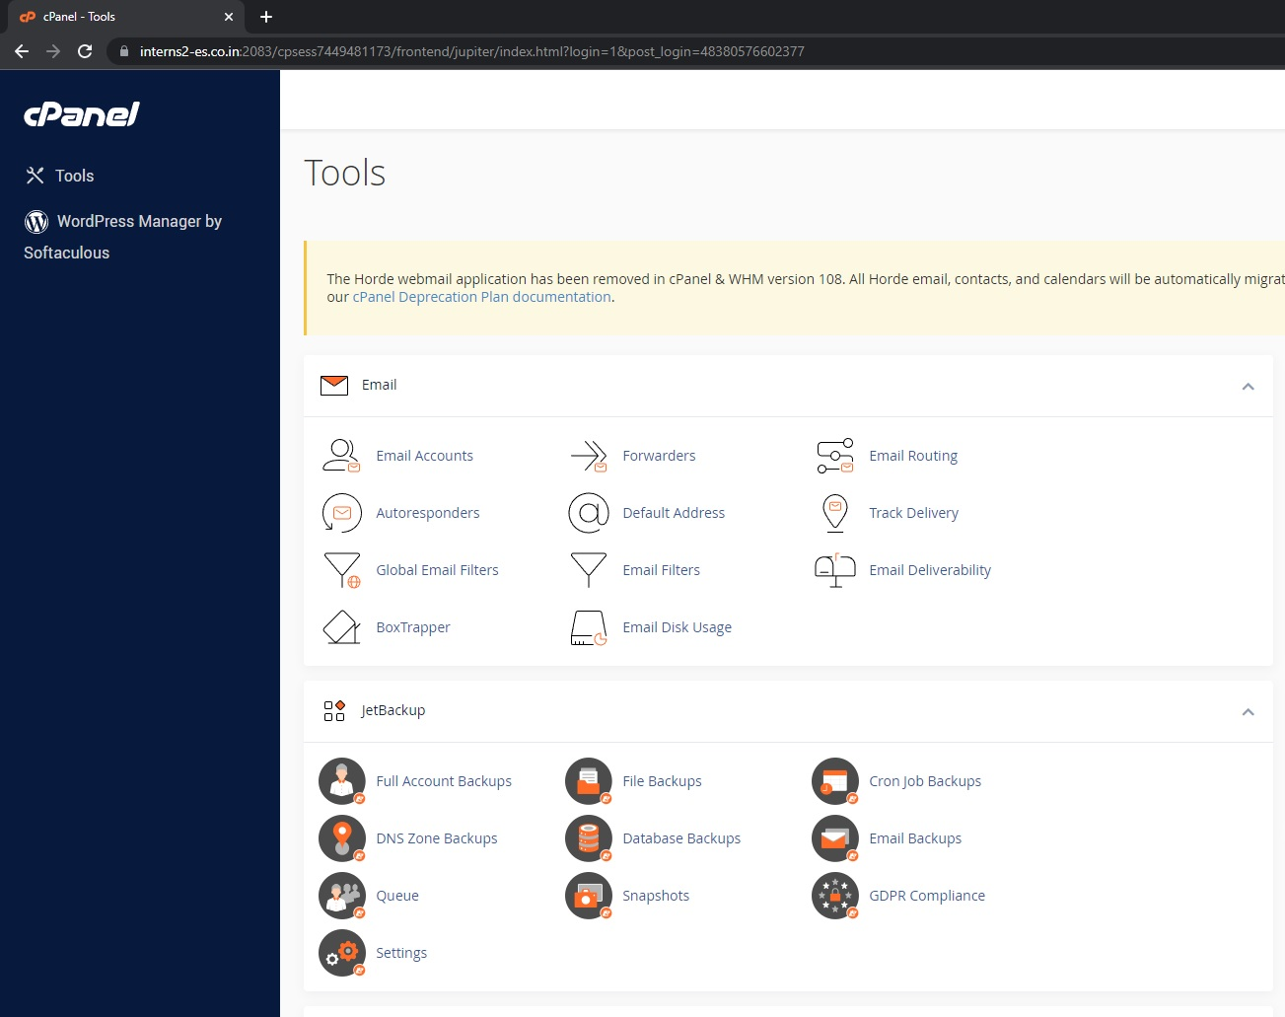
cPanel
cPanel is a popular control dashboard that helps to manage our web hosting server using a human-friendly web-based interface.
It lets you access important hosting features and configurations that would otherwise require technical knowledge.
By using cPanel we can create subdomains, emails, FTP account and many more.
We received cPanel username and password from our hosting provider, usually in the set of welcome emails received immediately after signing up.

Slide 7
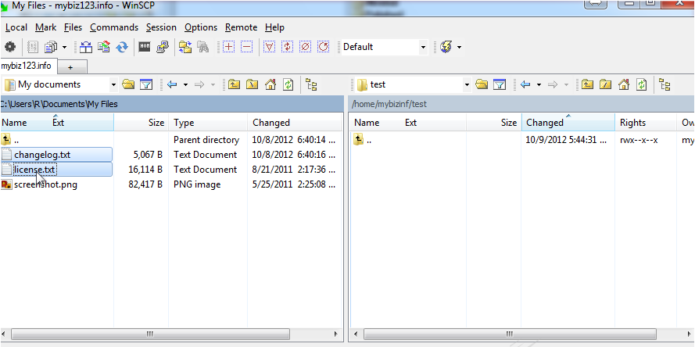
WinSCP Software
WinSCP is a popular SFTP client and FTP client for Microsoft Windows! It is used to Copy file between a local computer and remote servers using different file transfer protocols.
We can create FTP account in our cPanel and connect it to WinSCP to upload our local files into Server.
Its main function is secure file transfer between a local computer and a remote server.
Beyond this, WinSCP offers scripting and basic file manager functionality.

